Slide 1
Caesar Cipher & Statistical (Frequency) Analysis

Slide 2
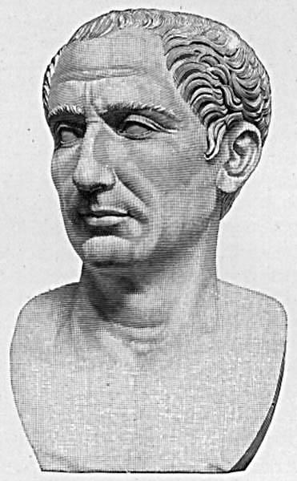
History of the Caesar Cipher
The Caesar cipher is a method of cryptography. It is named after Julius Caesar who used it to communicate with his army, around 100 BC.
Is one of the first recorded uses of cryptography.
It is a type of substitution cipher.

Slide 3
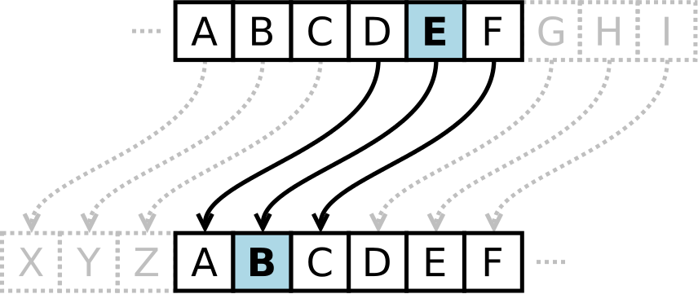
How it works.
For each letter of the alphabet, you would take its position in the alphabet, say 3 for the letter 'C', and shift it by the key number. If we had a shift of +3, that 'C' would be shifted down to an 'F' - and that same process would be applied to every letter in the plaintext.

Slide 4
Example Shift +3
S | A | L | L | Y
Plaintext
V | D | O | O | B
Ciphertext

Slide 5
Statistical (Frequency) Analysis
Works on the principle that “although the letters themselves change, their frequency does not.”
The most commonly used letters in the English language is the letters are, (e,a,r,I,o).

